Slide 1


Topic 7: Linear mixed-effects models (random effects)
Chapter 12
Chapter 7

Slide 2
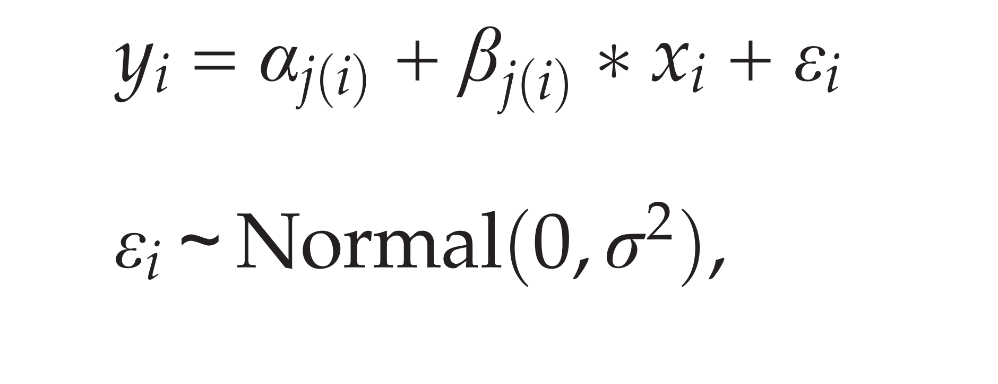
Recap: general linear models
Richard slide

Slide 3
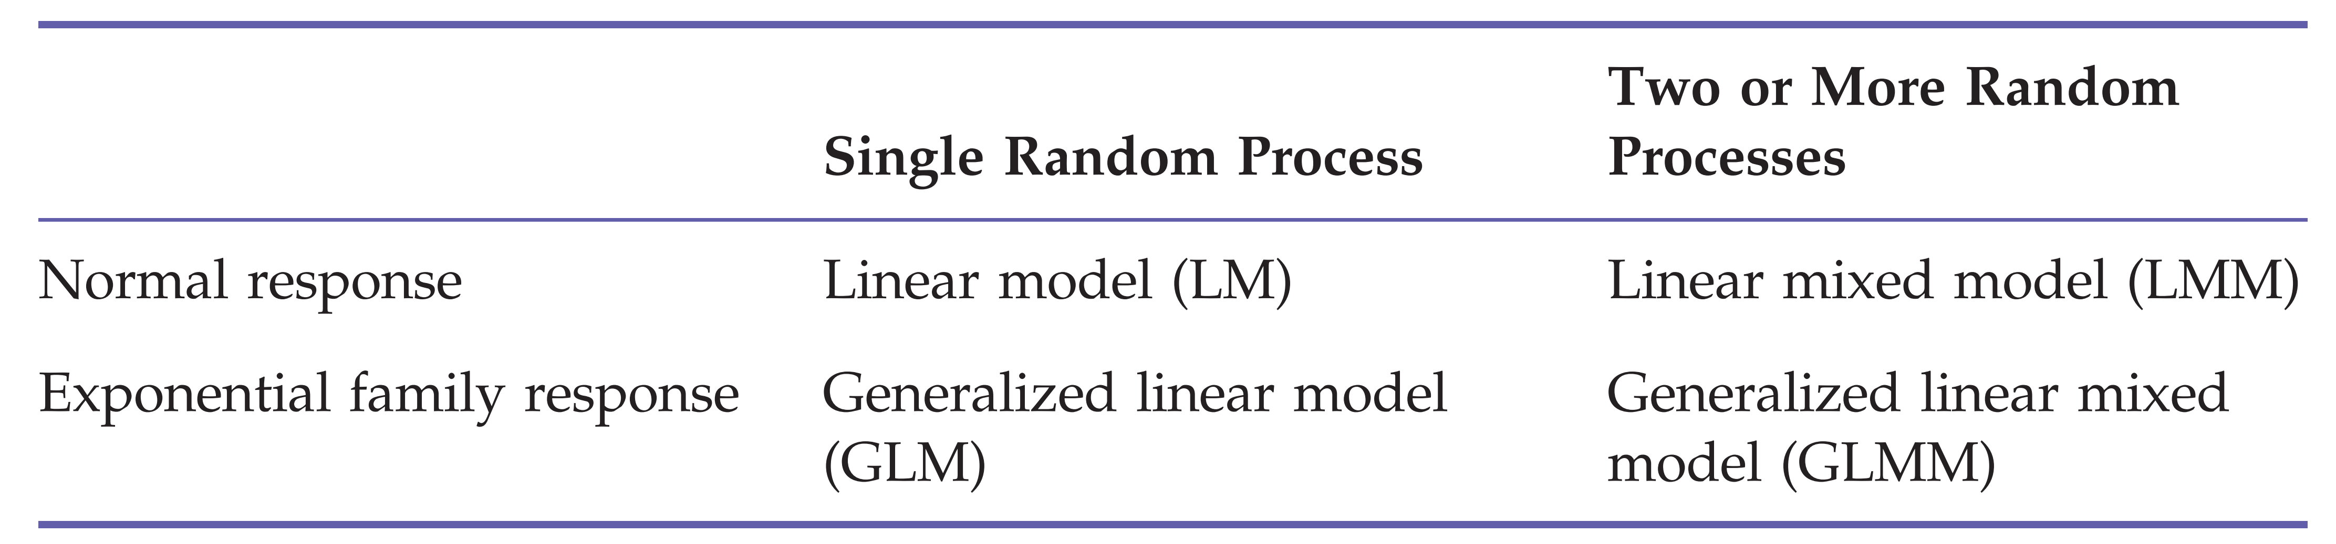
„The core of modern applied statistics“

Slide 4
Linear mixed-effects models
Mixed models = hierarchical models
Contain factors with both fixed and random effects
The presence of a random effect adds another layer of variance!

Slide 5
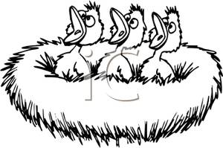
Example
Measure growth rates of nestlings in different nests
Mass measurements of each nestling several times during the nestling phase
Measurements from the same individual are likely to be more similar (grouped within nestlings - repeated measurements)
Individuals from the same nest are likely to be more similar (grouped within nests )
If the grouping structure of the data is ignored in the model, the residuals do not fulfill the independence assumption!!

Slide 6
Fixed or random effects?
Fixed effects have a finite (“fixed”) often low number of levels e.g. “sex” – (don’t mix it up with continuous variables!)
Random effects have a theoretically infinite number of levels of which we have measured a random sample. E.g. we can measure 5 or 10 or n nests
For fixed effects we are interested in the specific differences between levels (e.g., between males and females)
For random effects we are only interested in the between-level (= between-group, e.g., between-nest) variance rather than in differences between specific levels (e.g., nest A versus nest B)
It depends sometimes on the aim of the study whether a factor should be treated as fixed or random.

Slide 7
Fixed or random effects?
Fixed factors
Groups are predetermined, of direct interest, repeatable
e.g. treatment, sey, age class, season, habitat
Conclusions about differences among groups can only be applied to the groups of the study and cannot be generalized to other treatments, habitats…
Random factors
Groups are a random sample from a population of groups
e.g. individual, nest, field, school, study plot
Conclusions about differences among groups can be generalized to the whole population.
The variance between groups is the main interest not the specific group means!

Slide 8
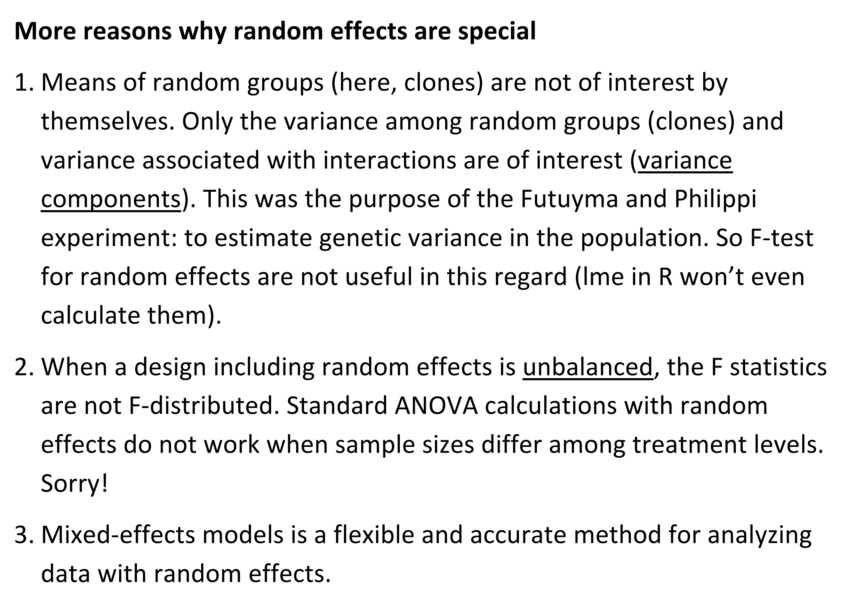
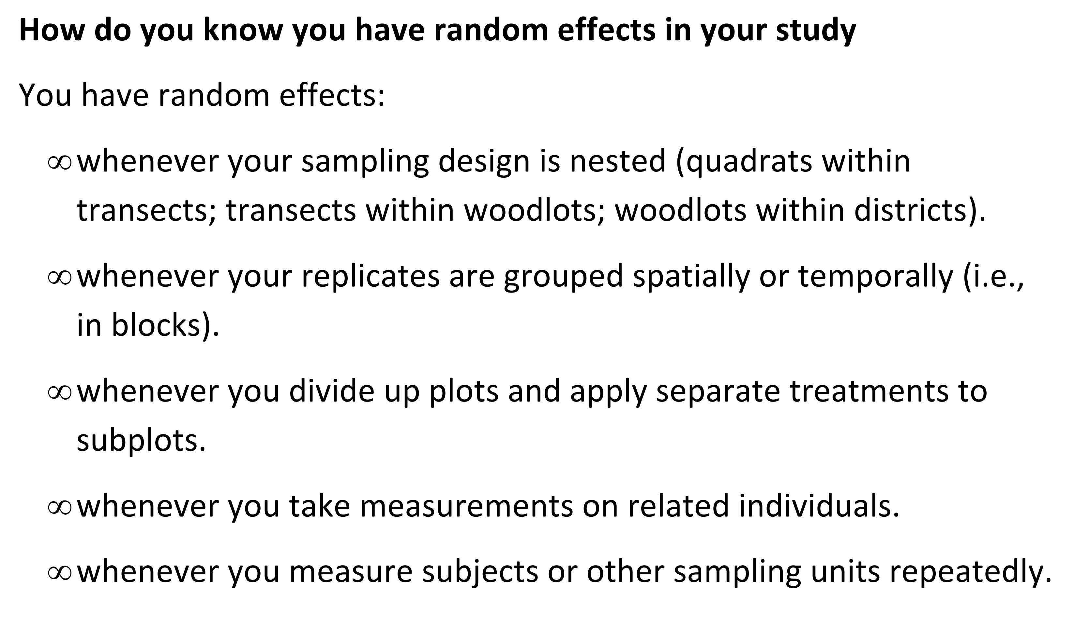
Fixed or random effects?

Slide 9
Random factors and partial pooling
Model with fixed factors: differences of the group means to the mean of the reference group are separately estimated as model parameters k - 1 (independent) model parameters, where k = number of groups (or number of factor levels).
Model with random factors: only one parameter, namely the between-group variance, is estimated. k differences from the population mean. These k differences are not independent.

Slide 10
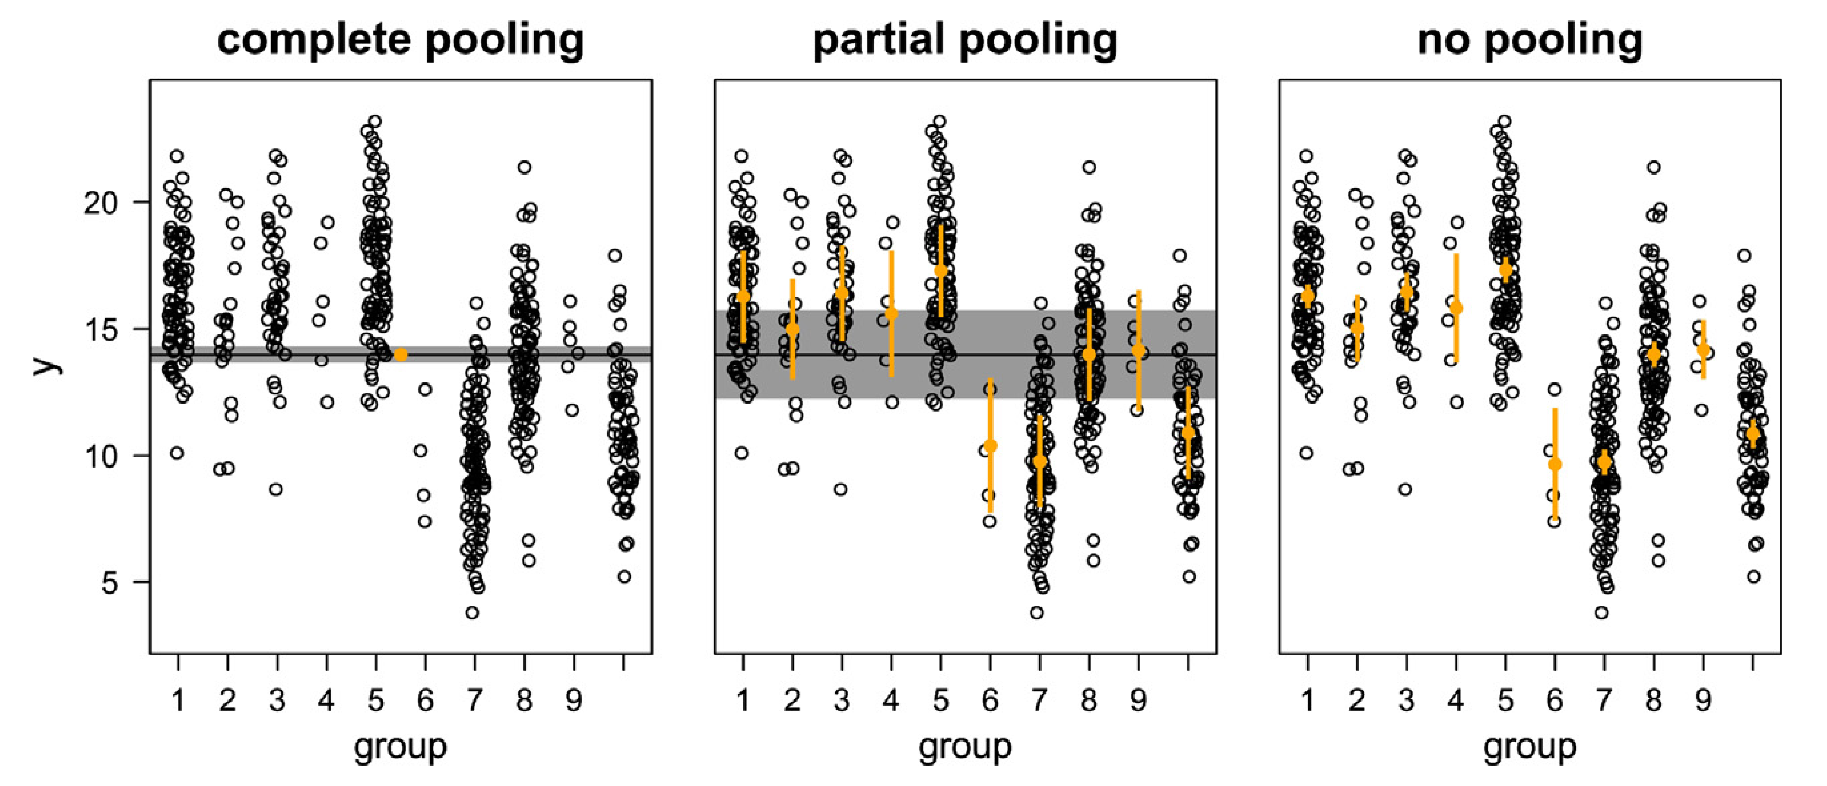
3 ways to obtain means of grouped data
1. Grouping is ignored – complete pooling
-> Pseudpreplication! we are too confident in the result because we assume that all observations are independent when they are not.

Slide 11
3 ways to obtain means of grouped data
2. Group means are estimated separately - no pooling (data from all other groups are ignored when estimating a group mean - equivalent to treating the factor as fixed) -> danger of overestimation of the between-group variance because the group means are estimated independently of each other

Slide 12
3 ways to obtain means of grouped data
3. Partially pooling - group means are weighted averages of the population mean and the unpooled group means. The weights are proportional to sample size and the inverse of the variance.

Slide 13
Advantages of partial pooling
Assumes that the group means are a random sample from a common distribution
Information is exchanged between groups.
Estimated means for groups with low sample sizes, large variances, and means far away from the population mean are shrunk toward the population mean
Group means that are estimated with a lot of imprecision (because of low sample size and high variance) are shrunk toward the population mean.
A consequence of the shrinkage is that the residuals are positively correlated with the fitted values

Slide 14
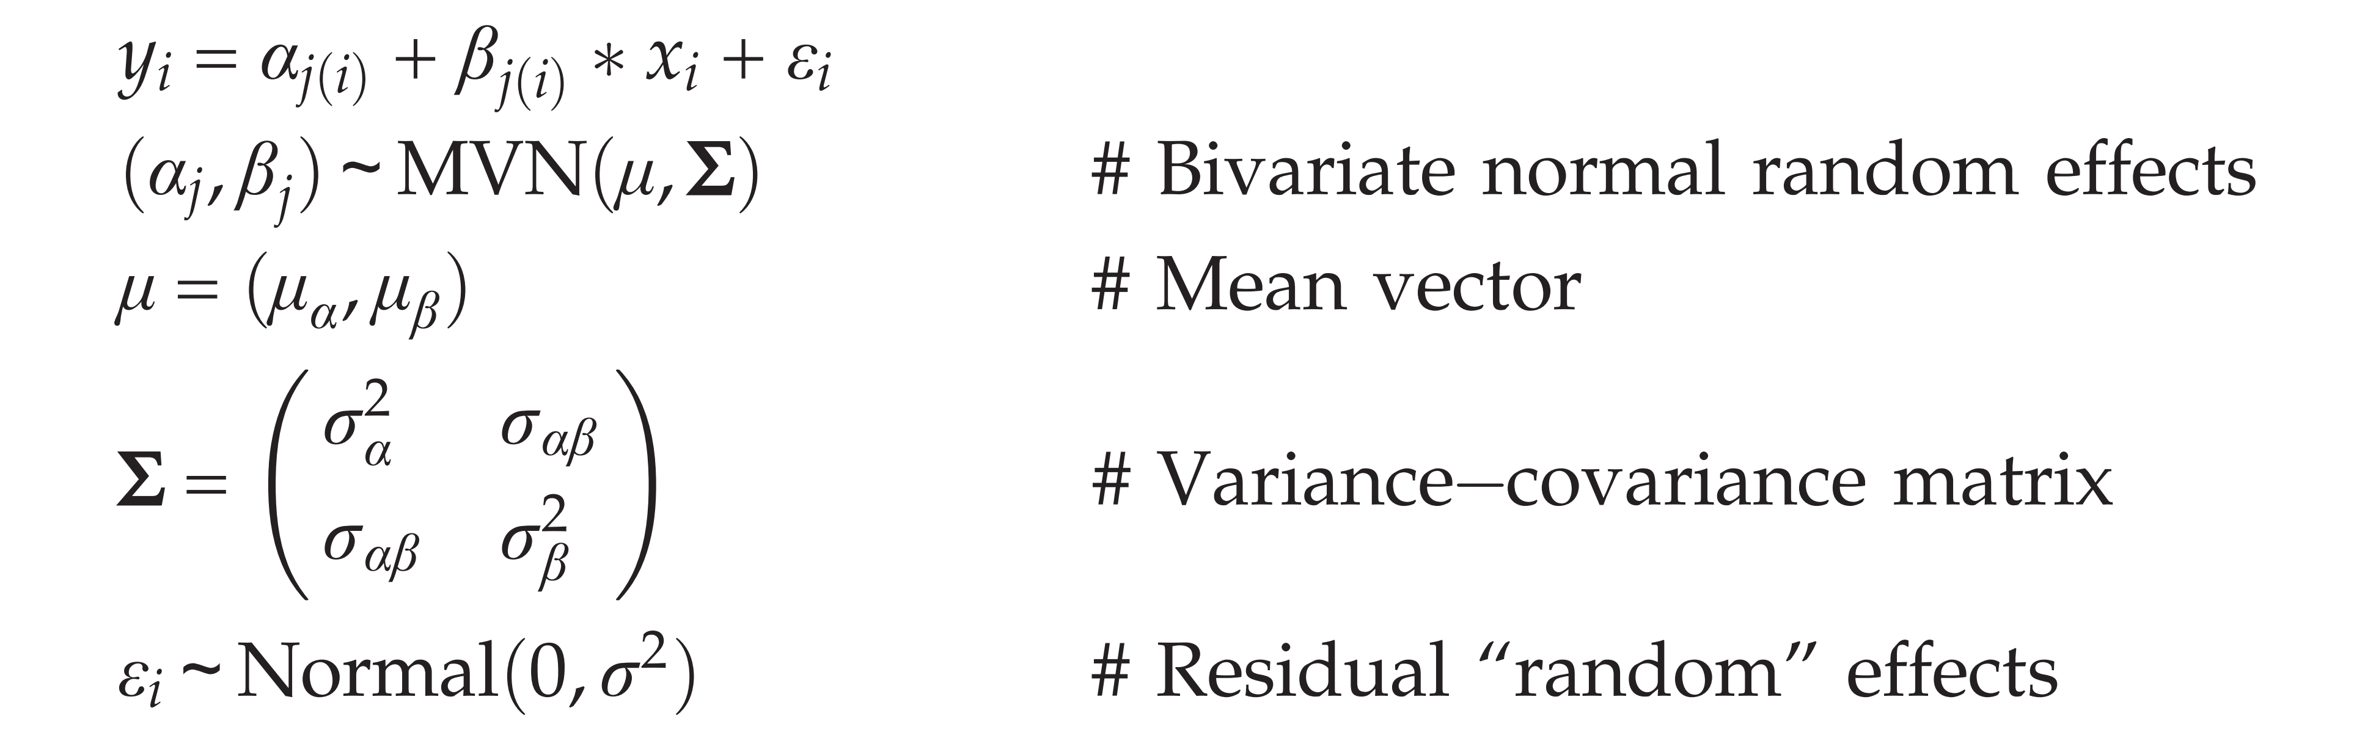
Linear mixed-effects models
To summarize: mixed models are used to appropriately estimate between-group variance and to account for non-independency among data points.
The presence of a random effect adds another layer of variance!

Slide 15
Fitting linear mixed-effects models in R
-> use lme4::lmer() – (lm() assumes all effects are fixed)
lmer() is used similarly to function lm()
random factors are added in the model formula within parentheses.
The “1” stands for the intercept and the “|” means “grouped by”, (1|Individual) therefore, adds the random deviations for each individual to the average intercept.

Slide 16
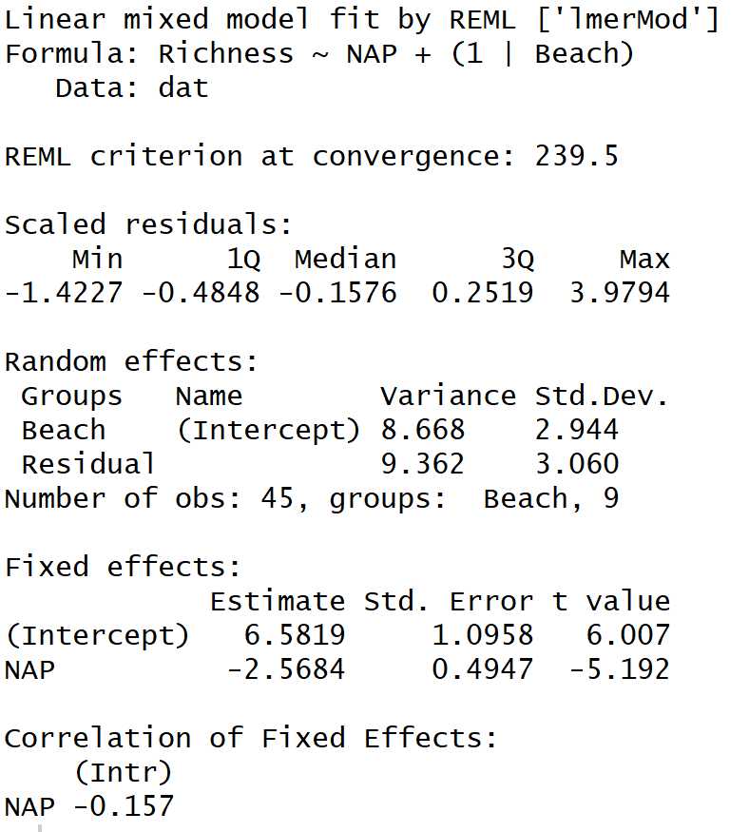
Interpretation
R output
No p-value
R script von Krissi unterlagen
No R²
Genauere Beschreibung

Slide 17
Interpretation
The estimation of standard errors for the model parameters in mixed models is difficult using frequentist methods
The problem is that in mixed models it is difficult to obtain the degrees of freedom.
However, for testing fixed effects, and when sample size is large, the approximate likelihood ratio test is reliable in practice.
In contrast, when testing random effects, or when sample size is small, the approximate likelihood ratio test can be misleading.
Solutions: lmerTest, bootstrapping, MCMC (bayesian method)

Slide 18
REML
Default for a mixed model: the restricted maximum likelihood estimation (REML) instead of the maximum likelihood (ML)
ML method underestimates the variance parameters because it assumes that the fixed parameters are known without uncertainty when estimating the variance parameters.
When sample size is large compared to the number of model parameters, the differences between the ML and REML estimates become negligible.
As a guideline, use REML if the interest is in the random effects (variance parameters) and ML if the interested is in the fixed effects.
The estimation method can be chosen by setting the argument “REML” to “FALSE” (default is “TRUE”).

Slide 19
Assumptions
plot(model) does not work here
Eventuell in R code oder weglassen
- richards teil

Slide 20
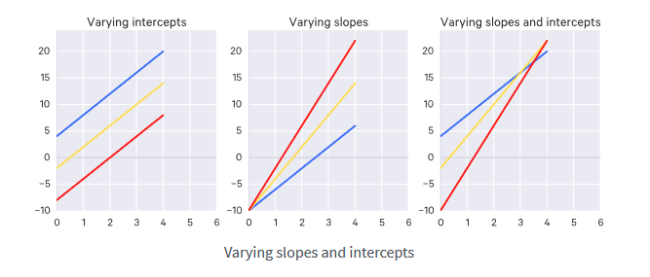
Random intercept and/or slope
Kurz was aus schweizer buch

